Slide 1
TRAVEL AND TOURISM
MANAGEMENT SYSTEM
PRESENTED BY
Chandini Sanapala

Slide 2


Schema and Tables creation
CREATE SCHEMA Travel_Tourism;
USE Travel_Tourism;
TABLES CREATION
CREATE TABLE Tourists (
tourist_id INT PRIMARY KEY,
name VARCHAR(50),
country VARCHAR(50),
age INT );
CREATE TABLE Destinations (
destination_id INT PRIMARY KEY,
place_name VARCHAR(100),
location VARCHAR(100),
category VARCHAR(50) );

Slide 3


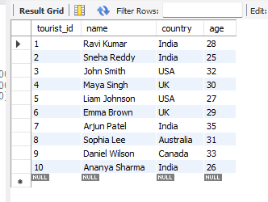
CREATE TABLE Bookings (
booking_id INT PRIMARY KEY, tourist_id INT,
destination_id INT,
booking_date DATE,
cost DECIMAL(10,2),
FOREIGN KEY (tourist_id) REFERENCES Tourists(tourist_id),
FOREIGN KEY (destination_id) REFERENCES Destinations(destination_id) );
CREATE TABLE Guides (
guide_id INT PRIMARY KEY,
name VARCHAR(50),
language VARCHAR(50),
destination_id INT,
FOREIGN KEY (destination_id) REFERENCES Destinations(destination_id) );
INSERT INTO Tourists VALUES
(1, 'Ravi Kumar', 'India', 28),
(2, 'Sneha Reddy', 'India', 25),
(3, 'John Smith', 'USA', 32),
(4, 'Maya Singh', 'UK', 30),
(5, 'Liam Johnson', 'USA', 27),
(6, 'Emma Brown', 'UK', 29),
(7, 'Arjun Patel', 'India', 35),
(8, 'Sophia Lee', 'Australia', 31),
(9, 'Daniel Wilson', 'Canada', 33),
(10, 'Ananya Sharma', 'India', 26);

Slide 4
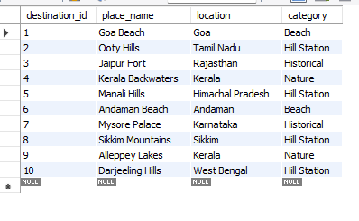
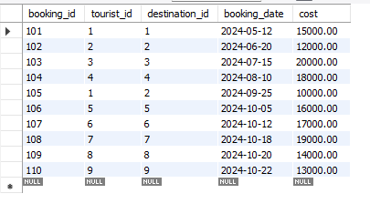
INSERT INTO Destinations VALUES
(1, 'Goa Beach', 'Goa', 'Beach'),
(2, 'Ooty Hills', 'Tamil Nadu', 'Hill Station'),
(3, 'Jaipur Fort', 'Rajasthan', 'Historical'),
(4, 'Kerala Backwaters', 'Kerala', 'Nature'),
(5, 'Manali Hills', 'Himachal Pradesh', 'Hill Station'),
(6, 'Andaman Beach', 'Andaman', 'Beach'),
(7, 'Mysore Palace', 'Karnataka', 'Historical'),
(8, 'Sikkim Mountains', 'Sikkim', 'Hill Station'),
(9, 'Alleppey Lakes', 'Kerala', 'Nature'),
(10, 'Darjeeling Hills', 'West Bengal', 'Hill Station');
INSERT INTO Bookings VALUES
(101, 1, 1, '2024-05-12', 15000.00),
(102, 2, 2, '2024-06-20', 12000.00),
(103, 3, 3, '2024-07-15', 20000.00),
(104, 4, 4, '2024-08-10', 18000.00),
(105, 1, 2, '2024-09-25', 10000.00),
(106, 5, 5, '2024-10-05', 16000.00),
(107, 6, 6, '2024-10-12', 17000.00),
(108, 7, 7, '2024-10-18', 19000.00),
(109, 8, 8, '2024-10-20', 14000.00),
(110, 9, 9, '2024-10-22', 13000.00);

Slide 5
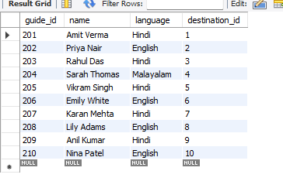
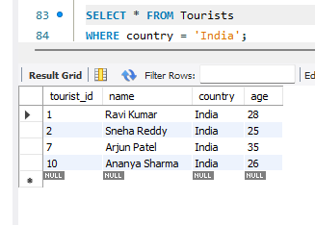
INSERT INTO Guides VALUES
(201, 'Amit Verma', 'Hindi', 1),
(202, 'Priya Nair', 'English', 2),
(203, 'Rahul Das', 'Hindi', 3),
(204, 'Sarah Thomas', 'Malayalam', 4),
(205, 'Vikram Singh', 'Hindi', 5),
(206, 'Emily White', 'English', 6),
(207, 'Karan Mehta', 'Hindi', 7),
(208, 'Lily Adams', 'English', 8),
(209, 'Anil Kumar', 'Hindi', 9),
(210, 'Nina Patel', 'English', 10);
Retrieving data by writing queries
1. Write a query to fetch tourist id,age and all tourists from india)
SELECT * FROM Tourists
WHERE country = 'India';
Explanation:
WHERE filters only the rows where the country is India.

Slide 6
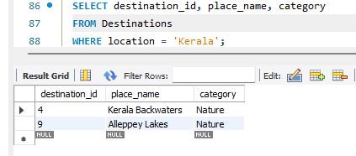
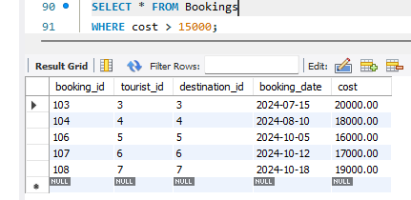
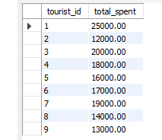
2. write a query to fetch placename and category with destination id of all destinations located in kerala.
SELECT destination_id, place_name, category
FROM Destinations
WHERE location = 'Kerala';
Explanation:
Filters rows by location = 'Kerala' to show only destinations in that state.
3.write a query to show bookings where the cost is greater than 15000
SELECT * FROM Bookings
WHERE cost > 15000;
Explanation:
Displays all bookings where the cost exceeds ₹15,000.
4. write a query to find the total bookingcost for each tourist
SELECT tourist_id, SUM(cost) AS total_spent
FROM Bookings
GROUP BY tourist_id;
Explanation:
SUM(cost) adds up all bookings per tourist using GROUP BY.

Slide 7
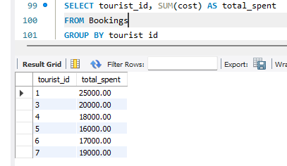
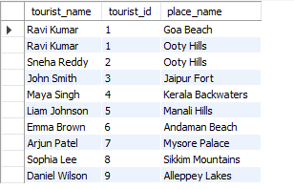
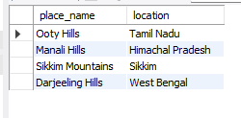
5. write query to fetch tourist_id and tourist who have spent more than 15000 in total
SELECT tourist_id, SUM(cost) AS total_spent
FROM Bookings
GROUP BY tourist_id
HAVING SUM(cost) > 15000;
Explanation:
HAVING is used to filter grouped results (not rows).
6.write a query to display tourist_id,touristnames with their destination names
SELECT t.name AS tourist_name, t.tourist_id, d.place_name
FROM Tourists t
JOIN Bookings b ON t.tourist_id = b.tourist_id
JOIN Destinations d ON b.destination_id = d.destination_id;
Explanation:
Combines three tables to show which tourist visited which destination.
7.write a query Fetch all destinations that belong to 'Hill Station' category
SELECT place_name, location
FROM Destinations
WHERE category = 'Hill Station';
Explanation: Filters the destinations by category

Slide 8
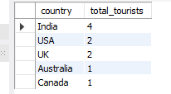
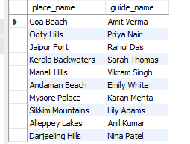
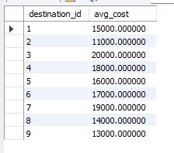
8.write a query to find the number of tourists from each country
SELECT country, COUNT(*) AS total_tourists
FROM Tourists
GROUP BY country;
Explanation:
COUNT(*) counts tourists grouped by country.
9. query to Display destinations and guide names assigned to them
SELECT d.place_name, g.name AS guide_name
FROM Destinations d
JOIN Guides g ON d.destination_id = g.destination_id;
Explanation:
Shows one-to-one relationship between destination and assigned guide.
10.write a query to Find average booking cost per destination
SELECT destination_id, AVG(cost) AS avg_cost
FROM Bookings
GROUP BY destination_id;
Explanation:
Uses AVG() to calculate mean booking cost per destination.

Slide 9
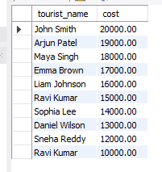


11.write a query to Display tourist names and booking costs in descending order of cost
SELECT t.name AS tourist_name, b.cost
FROM Tourists t
JOIN Bookings b ON t.tourist_id = b.tourist_id
ORDER BY b.cost DESC;
Explanation:
ORDER BY ... DESC arranges results from highest to lowest cost.
12.write aquery to Find the most expensive booking made
SELECT *
FROM Bookings
WHERE cost = (SELECT MAX(cost) FROM Bookings);
Explanation:
Uses a subquery to fetch the maximum cost and compares it.
13. Find destinations that have never been booked
SELECT place_name
FROM Destinations
WHERE destination_id NOT IN (SELECT destination_id FROM Bookings);
Explanation:
Uses a subquery with NOT IN to find destinations with no bookings.

Slide 10

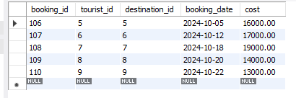
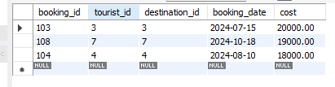
14.write a query to Show names of tourists who visited ‘Hill Station’ destinations
SELECT DISTINCT t.name
FROM Tourists t
JOIN Bookings b ON t.tourist_id = b.tourist_id
JOIN Destinations d ON b.destination_id = d.destination_id
WHERE d.category = 'Hill Station';
Explanation:
DISTINCT ensures each tourist name appears only once.
15.WRITE a query to Find all bookings made in October 2024
SELECT * FROM Bookings
WHERE MONTH(booking_date) = 10 AND YEAR(booking_date) = 2024;
Explanation:
Filters bookings based on month and year from a DATE column.
16.write a query to fetch the List of top 3 most expensive bookings
SELECT *
FROM Bookings
ORDER BY cost DESC
LIMIT 3;
Explanation:
LIMIT 3 restricts to only the top three rows after sorting by cost DESC.

Slide 11
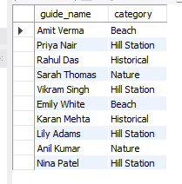

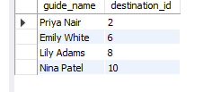
17. Show each guide with their destination category
SELECT g.name AS guide_name, d.category
FROM Guides g
JOIN Destinations d ON g.destination_id = d.destination_id;
Explanation:
Demonstrates a JOIN between Guides and Destinations.
18.write a query to Find the average age of tourists from India
SELECT AVG(age) AS avg_age
FROM Tourists
WHERE country = 'India';
Explanation:
Uses AVG() to compute average for filtered rows.
19.Write a query to Show all guides who speak English
SELECT name AS guide_name, destination_id
FROM Guides
WHERE language = 'English';
Explanation:
Simple filter with WHERE clause.

Slide 12
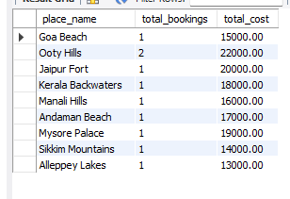
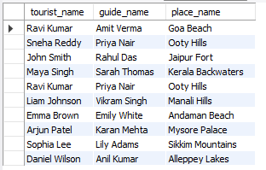
20. Display total bookings and total cost per destination
SELECT d.place_name, COUNT(b.booking_id) AS total_bookings, SUM(b.cost) AS total_cost
FROM Destinations d
JOIN Bookings b ON d.destination_id = b.destination_id
GROUP BY d.place_name;
Explanation:
Shows aggregation of bookings and sum of cost per destination.
21. Show all tourists and their assigned destination guides
SELECT t.name AS tourist_name, g.name AS guide_name, d.place_name
FROM Bookings b
JOIN Tourists t ON b.tourist_id = t.tourist_id
JOIN Destinations d ON b.destination_id = d.destination_id
JOIN Guides g ON d.destination_id = g.destination_id;
Explanation:
Joins all 4 tables to connect tourists → destinations → guides.

Slide 13
Conclusion:
This, Travel and Tourism Management System helped me understand how SQL can be used to store, manage, and analyze real-world data efficiently. By creating multiple tables and connecting them through relationships, I learned to use commands like joins, group by, and subqueries. This project improved my practical knowledge of databases and showed how SQL supports real applications like travel management systems.”
Thank you..

